Slide 1
Operating system
Part II: Problems and Ideas in OS
By KONG LingBo (孔令波)
Notes:
看看 OS 要考虑哪些问题!

Slide 2
Services
Problems and ideas when implementing OS
Problems: EMM+GSD
Concurrency, Resource limitation, Security, GUI, …
Ideas: Multiplex resource + Synchronize programs
Multiplexing resources based on interrupt mechanism
Synchronize the access of the limited resource among the related programs
Evolution of OSs’ structures
Construct OS with so many functions
System Call/API
How to use the functions defined in OS?
How to load and run OS?
Notes:
[2016年3月4日00:28:37] 这一章可以作为界定 OS 功能的进一步详细深入 – you have to know clearly what you want to cope with, and then you can always find methods:
Top goal of OS: is to support the execution of many programs CONCURRENTLY with limited resources
By “execution of many programs”, it means the fact that you have to represent program 1st as files stored in HD (or other secondary media) – M1, then copy instructions and data into main memory, finally configure CPU to execute instructions one after another - E
By “limited resources” it means von Neumann architecture – 1 CPU, 1 limited main memory space (M2) and 1 limited HD space (together with other devices)
By “CONCURRENTLY”, it means many troubles you should carefully find methods
Main memory space is limited – how to keep larger program?
Quick CPU switching
Resource sharing – deadlock and data consistency (also called synchronization)
Friendly interface – System calls (how to encapsulate the system function for other programs?) and GUI (how to embed GUI into OS kernel?)

Slide 3
How to understand the problems in OS?
Same as in other courses/theories, we could start from simple situation
1:1:M is only for one program whose size is smaller than that of the available space in MM
“the available” here is because “OS also needs some MM space”
EMM indicates the common problems: HOW
Execution → CPU
How to configure CPU (set instruction and parameter to registers) to run your program?
You’ve understood this through CO course (☺ I hope)
Mapping 2 → from File to Hard disk space
Your program is first represented as files in hard disk (usually). How to organize many files?
Mapping 1 → from File to Main Memory space
The fact from von Neumann gives that your programs should copied into MM space

Slide 4


However, OS is more complicated
Complexity is caused by the resource limitation, just as in real life
EMM is still the hint to understand the complicated situation
Mapping 1 → “Large program v.s small MM” problem
4GB now is popular, but
http://www.gamersky.com/z/ac2/

Slide 5


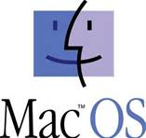
Modern OS is more complicated
And, the concurrency makes OS more complicated.
By concurrency, it means
Many programs are running in a period; but only one is running at a time!
You’ve benefited from this by using modern OSs – Windows, Ubuntu, Mac OS
You can listen to some music, “at same time”, you can edit some documents, maybe you can also read some materials for references
Concurrency is now the indispensable property of modern OSs!

Slide 6
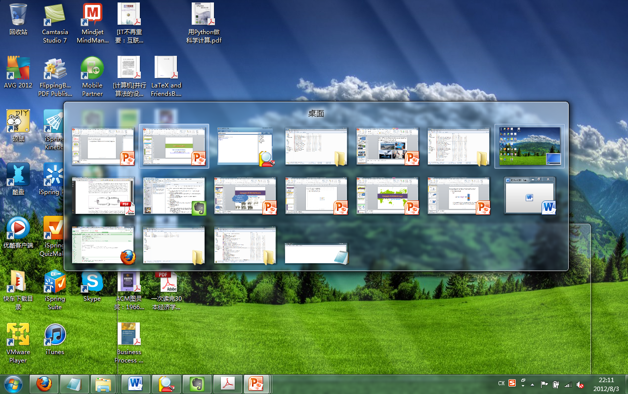
Concurrency is now the indispensable property of modern OSs

Slide 7
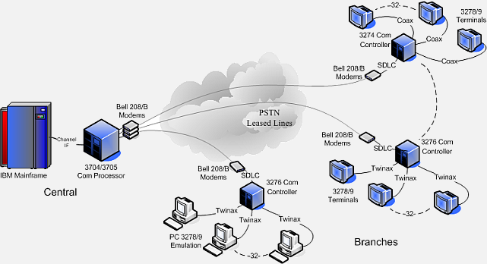
Concurrency is more critical for larger computers providing services for many clients at same time, like previous mainframe
In fact, most topics (problems and ideas) for modern OSs are first proposed for this kind of computers
http://www.advancedrelay.com/ci/home/banking

Slide 8
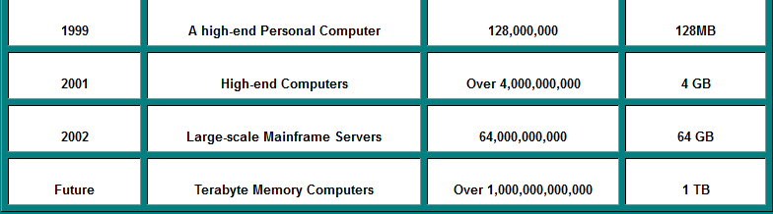
However, benefit always comes along with pains! Concurrency leads modern OS to be more complicated
Mapping 1 → “small MM v.s Large program” problem becomes more rigid even with larger and larger MM

Slide 9
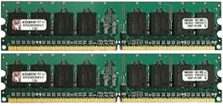
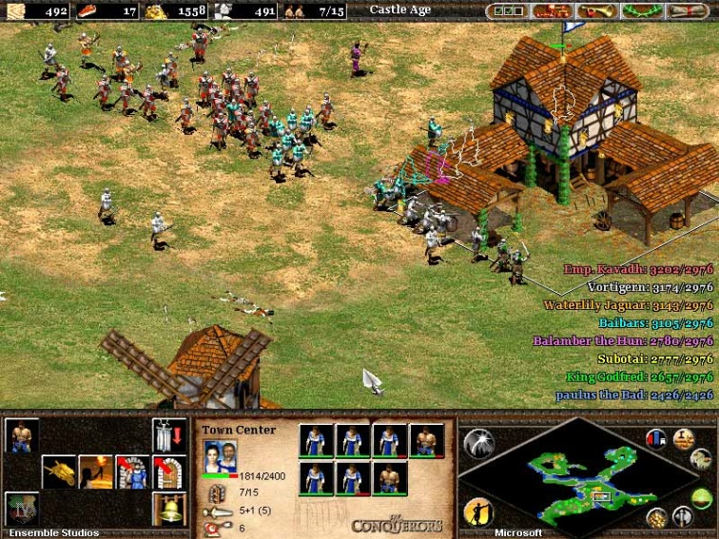
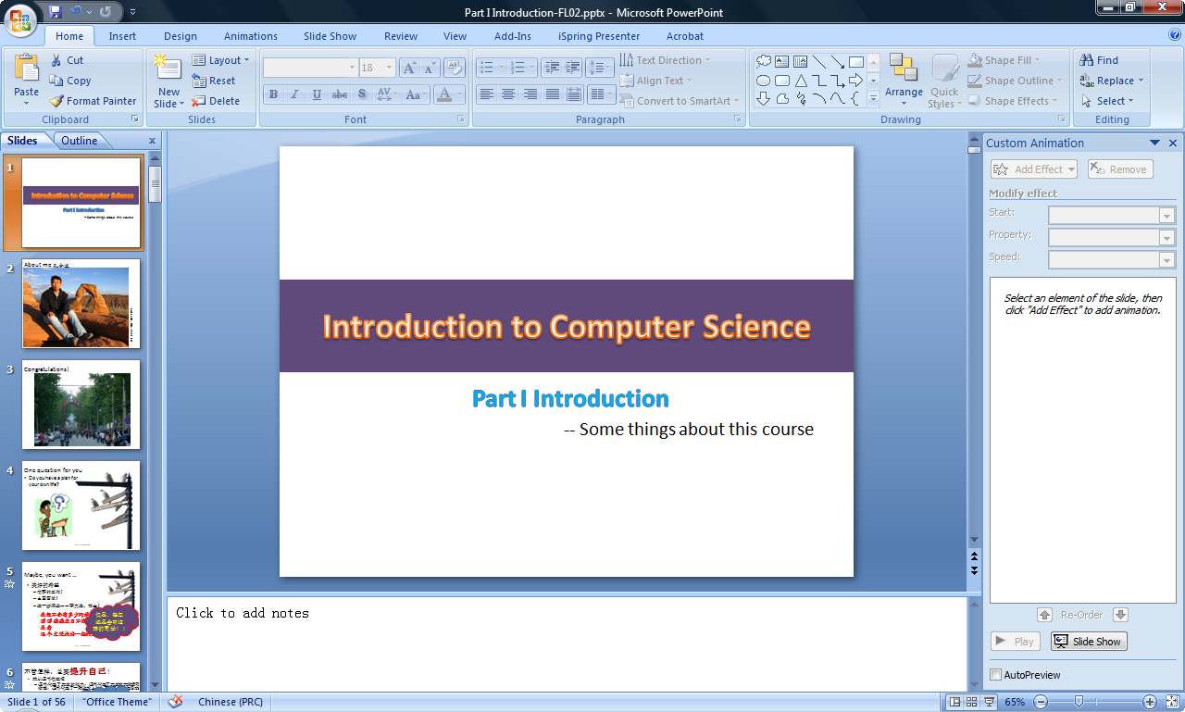
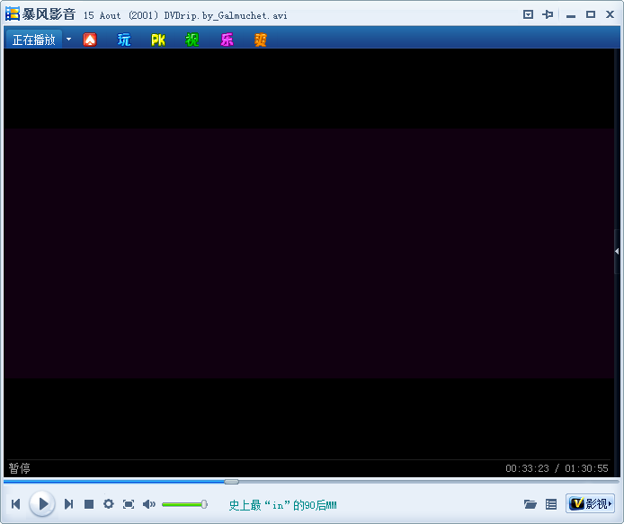
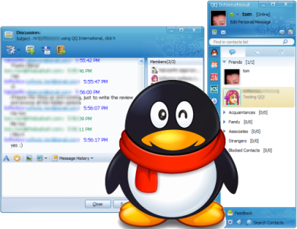


User’s requests could always break down the ability of the provider’s ☹
Main memory [主存]
Linear addressed space!
Called multiprogramming
[多道程序]
0010
0011
0012
0013
0110
0111
0112
0113

Slide 10
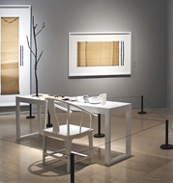
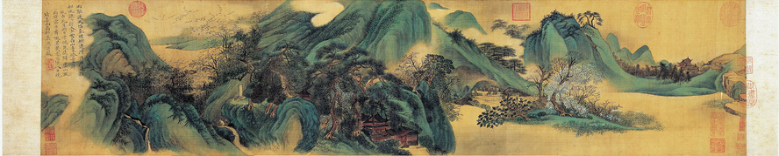
Idea to overcome “small MM v.s Large program” problem?
Multiplexing MM!
Cut programs into smaller segments, and copy the segment (containing instructions for execution) when needed
This is like you paint a long picture on a small desktop
Of course you should find other position to keep the rest.

Slide 11
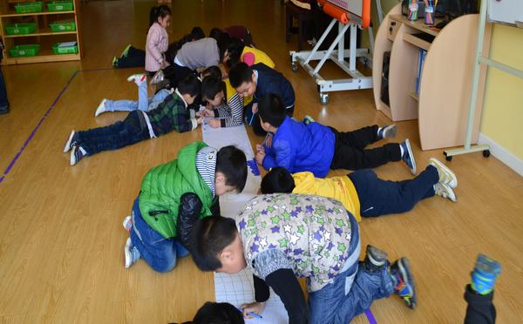
Pay attention to another keyword – Parallel
Don’t be confused with Concurrency.
Parallel means to do many things at same time!
In computers, this always means a computer has many CPUs. This is the property of modern server computers
This also means many children draw the long picture ☺

Slide 12
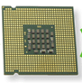
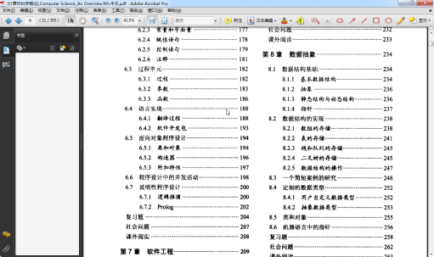
Execution → “1 CPU v.s many programs” problem

Slide 13
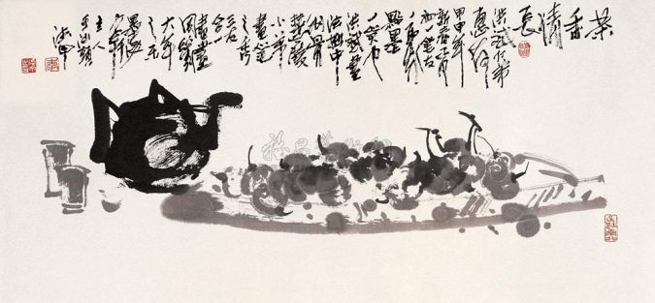

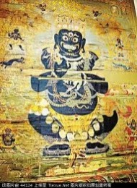
Idea to overcome “1 CPU v.s many programs” problem?
Multiplexing CPU!
This means to switch CPU among those concurrent programs quickly
This is like you paint several pictures on a small desktop, not one picture after another, but “one part of one picture after another part of other pictures”
Of course you should find other position to keep those pictures.

Slide 14
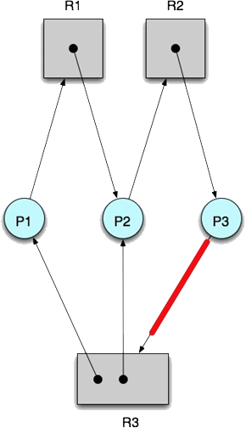

Concurrency also leads to other considerations
Improper resource allocation may lead to DEADLOCK
Problem of Resource competition
Each program needs some resources – memory, HDD, CPU, etc.
There must be competition among programs when running them concurrently

Slide 15
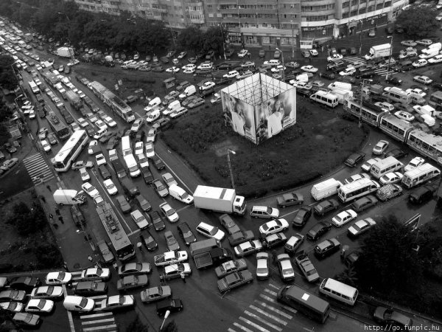
Notes:
Deadlock is a interesting topic in OS, which we should consider carefully

Slide 16


Other considerations
Of course you don’t want this happen when you deposit your money - Synchronization
Problem of Resource competition
Data inconsistency is another issue we should consider carefully when competing.
Depositing [存款]
100
100
100
+ 50
+ 100
150
200

Slide 17
Idea to overcome “Resource competition (data inconsistency and deadlock)” problem?
Synchronizing the execution of the related programs
One resource:
The related programs should access the resource mutually exclusively.
More than one resources:
?? Complicated, and touch later ☺
Could you infer some methods from your own traffic experience?
Hint is that you should conclude the conditions causing this kind of situation, as you cope with the real life problems , such as the light could not be turned on, etc.

Slide 18

By “mutually exclusively”, it’s like you and other persons share one washing machine, WC, coffer, etc.
No others could use this resource when you are using it.
Could you infer the key for this?
The lock (password)!
and the rules to use it
Apply for the lock first. You can use the resource only if you succeed.
You should release the lock after you finish to use the resource.
coffer [ˈkɔfə] n. 保险柜, 保险箱

Slide 19

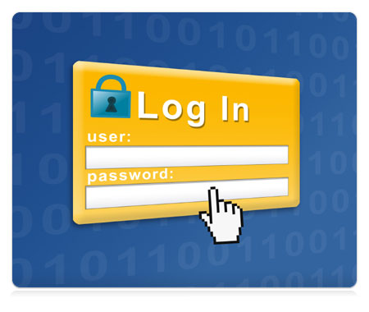
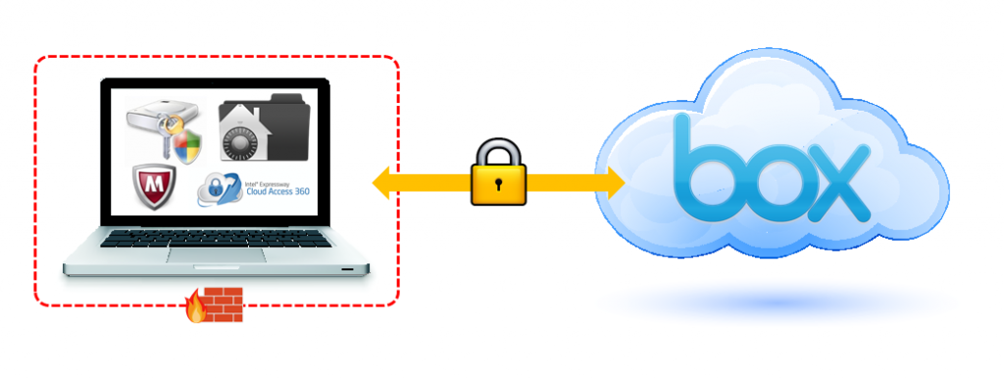

Security?
Problem: The essence is the data security!
Inside – in a computer system
Everyone can only access his/her own data! – Authorization.
Outside – during the data transmission
No one could hack the data flowing in the network – Encryption.

Slide 20
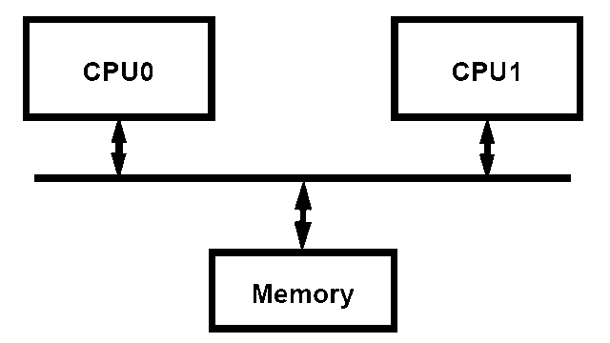
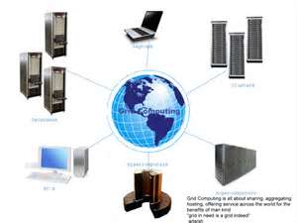
Other considerations
Advanced topic – multi-processor system
All those issues listed before (multiplexing, Synchronization, deadlock, protection etc. ) should be reconsidered
⬅ this part will be covered in this course, which depends ….

Slide 21
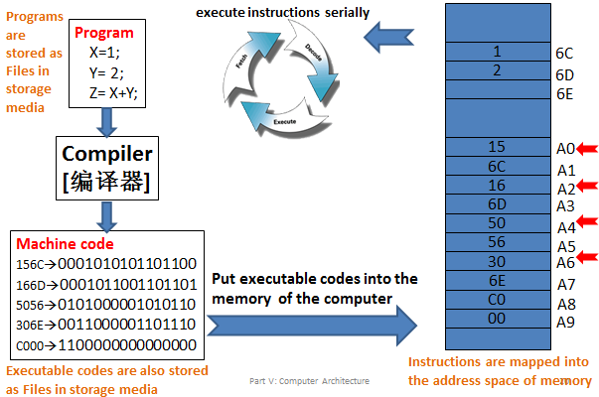
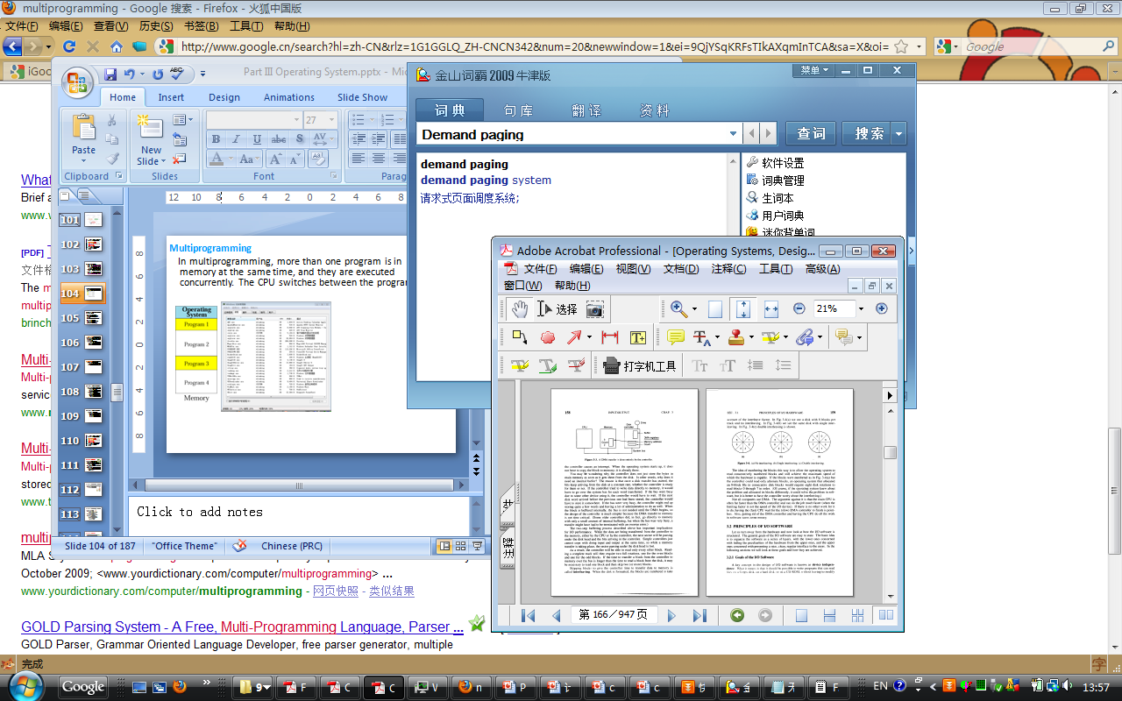
3 hints to follow!
How to manage resources for
Running a program?
Supporting concurrency?
1 CPU, many programs
Small MM, large program
Synchronization problem
Keeping security?
Control illegal access
Notes:
Security 一词, 教科书上将之分割为两层含义 – Protection 和 Security. 其实, 我以为就是数据访问控制的安全和数据传输的安全机制 – 没有必要分成两个词! [[2013-02-02 于光·影斋]]

Slide 22
and,
Not “Electro-Magnetic Measurement 电磁测量”
3 core tasks – EMM
Execution → CPU
Configurations for executing one program
Switching execution of concurrent programs
Mapping 2 → from File to Hard disk space
How to represent files in hard disks?
This is the fundaments to understand storing data in other media
Mapping 1 → from File to Main Memory space
Problem of Small MM v.s Large size of programs
How to allocate space
for a program?
for many programs?

Slide 23
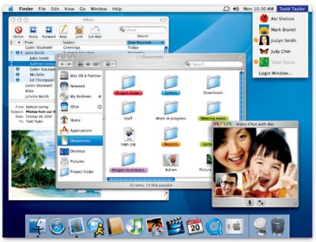
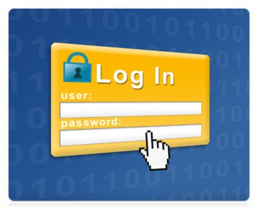



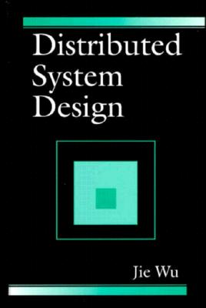
and,
Not “Greenwich Sidereal Date: 格林尼治恒星日期”
3 value-added tasks – GSD
Graphic User Interface
How to provide friendly interface for users?
Security
Inside and Outside?
Extension of EMM to Distributed systems
Multiprocessor system → Parallel
Many programs could run at the same time now!
Data consistency problem and Deadlock are more urgent!

Slide 24
Support to execute many programs concurrently [with limited resources][Local or Remote]
Friendly Interface:
GUI system (based on OO)
OS’s responsibility
[programming]
Carry out the security strategy:
Control the resource access safely
Carefully sharing resources among programs:
Multiplexing + Synchronization
Manage the resources:
Define the necessary information (Data Structure) for those resources
Limited resources: 1:1:M – von Neumann

Slide 25
Support to execute many programs concurrently [with limited resources] [Local or Remote]
Friendly Interface:
GUI system (based on OO)
Distributed Computing:
Providing services for remote computers
OS’s responsibility
[programming]
Carry out the security strategy:
Control the resource access safely
Carefully sharing resources among programs:
Multiplexing + Synchronization
Manage the resources:
Define the necessary information (Data Structure) for those resources
Limited resources: 1:1:M – von Neumann

Slide 26
Other fundamental problems
How to identify the program you want to run?
How to represent and organize files in HDD?
With the help of CO to understand how those bits are recorded
How to allocate limited MM to programs?
How to execute the ready program?
You have learned in Computer Organization
How to support GUI?
How to carry out inner and outer security?
How to carry out CPU switching, Lock mechanism, …
All we need is to design data structure and related operations ☺
Yes, DSA is important!

Slide 27
Services
Problems and ideas when implementing OS
Problems: EMM+GSD
Ideas: Multiplex resource + Synchronize programs
Construct OS
Evolution of OSs’s structures
Simple structure/monolithic structure
Modular, Layered, Microkernel
Trend – Virtual machine
How to use the functions defined in OS?
System Call/API
How to load and run OS?

Slide 28
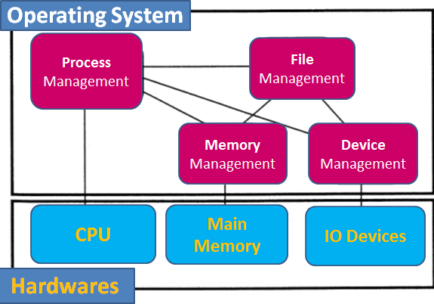
We’ve learned – 4 components
We can distill 4 kinds of resources / concepts
CPU, Main Memory, Hard Disk, File
Modern OS has 4 fundamental components

Slide 29
Are you kidding?! This small?!! However, map them into function numbers
However, OS is more complex!
There are so many functions implemented in OS!
Kernel size (EMM+S, without those drivers, etc.) of many OSs
Unix 32/V (VAX) 180k
BSD 4.3 (VAX) 640k
Mach 2.0 (VAX) 1000k
SunOS 4.03 (Sun 3, Sun 4) 2400k
Windows NT (x86) 4000k
http://www.gordoni.com/os-sizes.html

Slide 30
Based on my experience in Code::Blocks, the C code of whole classic linked list is 3KB. Therefore,
Unix 32/V (VAX) ~60
BSD 4.3 (VAX) ~214
Mach 2.0 (VAX) ~334
SunOS 4.03 (Sun 3, Sun 4) ~800
Windows NT (x86) ~1334
Have you ever experienced to manage 200 entities?
Like 200 Books? Cloths? persons? Especially they have some kind of relationships?
Organized structure! OS uses this too!
BTW, do you remember bonus? You could do me a favor to find more precise information about the implementation of current OSs?

Slide 31
Modular structure (Monolithic)
Better application Performance
Difficult to extend
Ex: MS-DOS
Application
Programs
Application
Programs
User Mode
Kernel Mode
System Services
Hardware

Slide 32
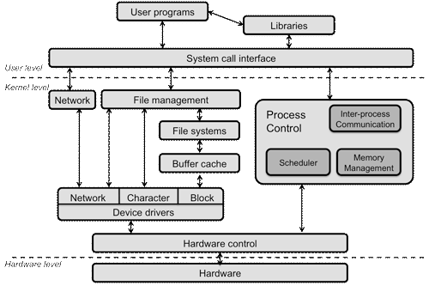
Structure of a typical operating system
http://www.cs.rutgers.edu/~pxk/416/notes/03-concepts.html

Slide 33
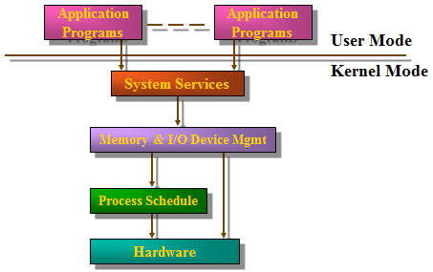
Layered structure
Easier to enhance;
Each layer of code access lower level interface
Low-application performance
Ex: Old Unix

Slide 34
Traditional OS
Application
Programs
Application
Programs
User Mode
Kernel Mode
OS
Hardware
OS Designer

Slide 35
New trend in OS design
Application
Programs
Servers
Application
Programs
User Mode
Kernel Mode
Microkernel
Hardware

Slide 36
Microkernel/Client Server OS 1990s
Tiny OS kernel providing basic primitive (process, memory, IPC)
Traditional services becomes subsystems
OS = Microkernel + User Subsystems
Ex: Mach, PARAS, Chorus, etc.
Client
Application
Thread
lib.
File
Server
Network
Server
Display
Server
User
Kernel
Microkernel
Send
Reply
Hardware

Slide 37
微内核(microkernel)
内核(kernel)
操作系统中实现基本功能的代码，它常驻内存并运行于特权方式。
单体内核(monolithic kernel)/宏内核(macro-kernel)/分层内核(Layered kernel)
内核实现操作系统的所有基本功能（包括调度、文件系统、连网、设备驱动程序、内存管理等等）
一般用一个进程实现，内核代码共享同一个地址空间，每一模块可以调用任意其它模块和使用内核所有核心数据
效率高，但难于修改和扩充
例子：Unix/BSD、Linux/Android、Mac OS 1.0~8.5.1、DOS、Windows 1~3.1/95/98/ME
微内核（microkernel）
内核只实现最基本功能（包括地址空间、IPC[InterProcess Communication，进程间通信]和基本调度）
更多的功能代码组织为多个进程，各自独立使用自己的地址空间，运行于非特权方式
客户/服务器模式，设计简单灵活，适用于嵌入式与分布式环境，但效率稍低
例子：Windows NT 3.1/3.5/3.51、Mac OS 8.6~9.2.3（nanokernel 纳米/超微内核）、Minix、Mach（马赫[奥地利物理家/1倍音速]，卡内基·梅隆大学1985年开发的一种分布式与并行操作系统的研究内核，最后的版本为1994年推出的3.0）、QNX（加拿大量子/QNX软件系统公司1982年开发的一种嵌入式商用类Unix操作系统，2010年被黑莓公司获得，当前最新版本是2014年3月推出的6.6）
混合内核（hybrid kernel）
微内核与宏内核的结合（也可算作单体内核中的一类）
具有微内核结构，按宏内核实现
例子：Windows NT(4.0/2000/XP/Vista/7/8/10)、XNU（Darwin 的核心，源自Mach和BSD，用于苹果公司的Mac OS X、iOS、watchOS和tvOS）

Slide 38
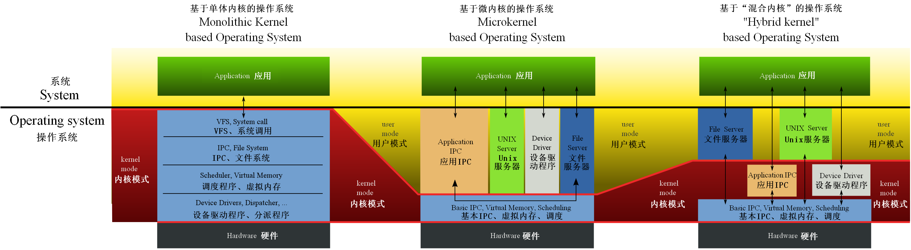
不同内核类型操作系统的结构比较
IPC = InterProcess Communication，进程间通信
VFS = Virtual File System，虚拟文件系统
38

Slide 39
Virtual Machines
Multiplexing computers
Virtual Machines: simulate OSs on one computer hardware
Hardware is abstracted into several different execution environments
Virtual machines
Each virtual machine provides an interface that is identical to the bare hardware
A guest process/kernel can run on top of a virtual machine.
We can run several operating systems on the same host.
Each virtual machine will run another operating system

Slide 40
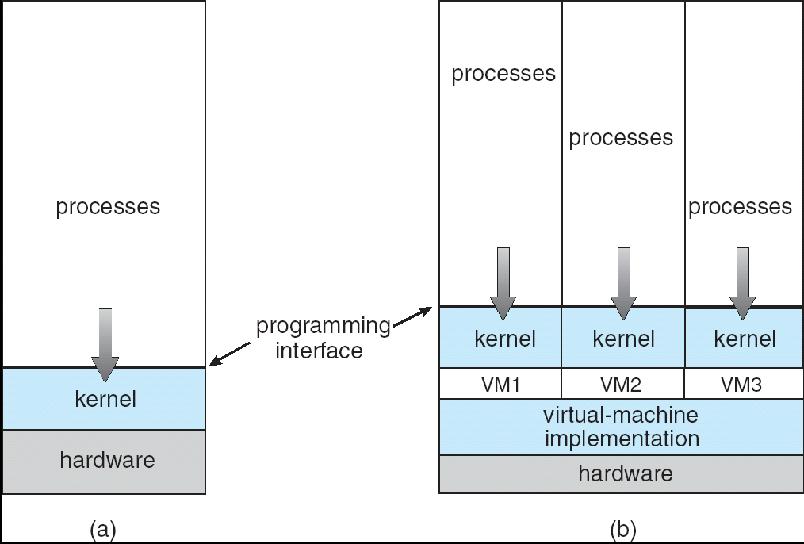
Non-virtual Machine
Virtual Machine

Slide 41
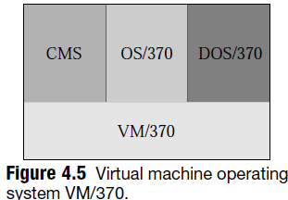
However, VM idea is not new at all
It was first proposed in 1970s
The Conversational Monitor System(CMS) is a single-user operating system, while the OS/370 and DOS/370 are multiprogramming operating systems.
A user process is unaware of the presence of the VM/370—it sees only the guest OS that it uses.
Users can choose what OS they want to use when logging in

Slide 42
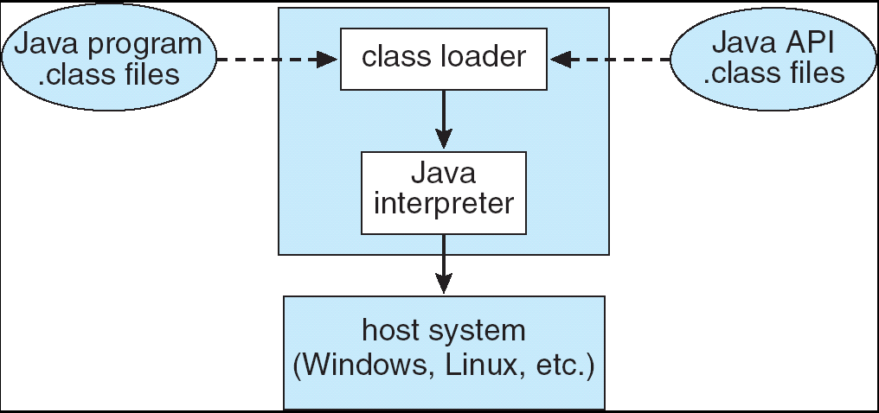
VM: Examples
The Java Virtual Machine
VMware
Abstracts Intel X86 hardware
Java virtual machine
Specification of an abstract computer
.NET Framework
Java consists of
Programming language specification
Application programming interface (API)
Virtual machine specification
The Java Virtual Machine allows Java code to be portable between various hardware and OS platforms.
PPTs.2012\Part 03 OS structures-FL.pptx

Slide 43
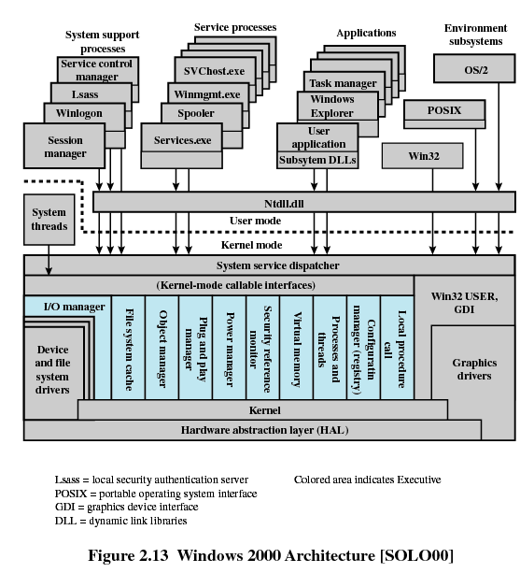
Hybrid

Slide 44
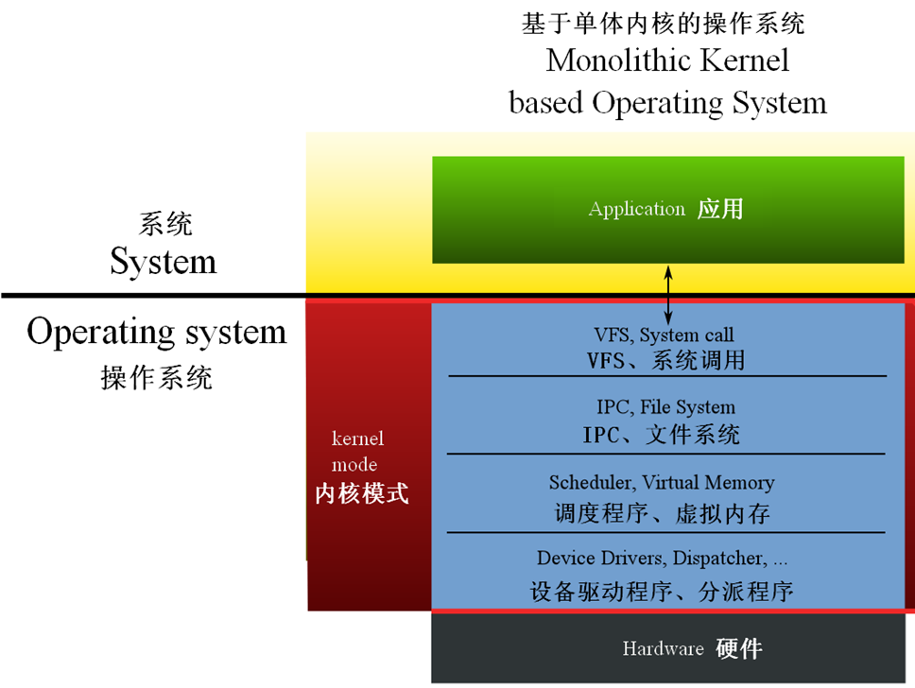
IPC = InterProcess Communication，进程间通信
VFS = Virtual File System，虚拟文件系统

Slide 45
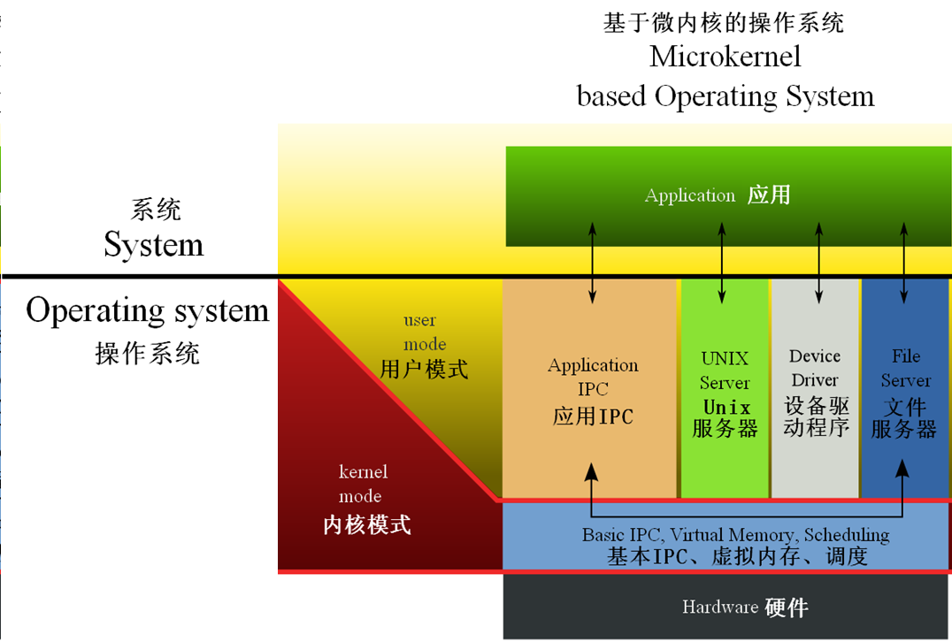
IPC = InterProcess Communication，进程间通信
VFS = Virtual File System，虚拟文件系统

Slide 46
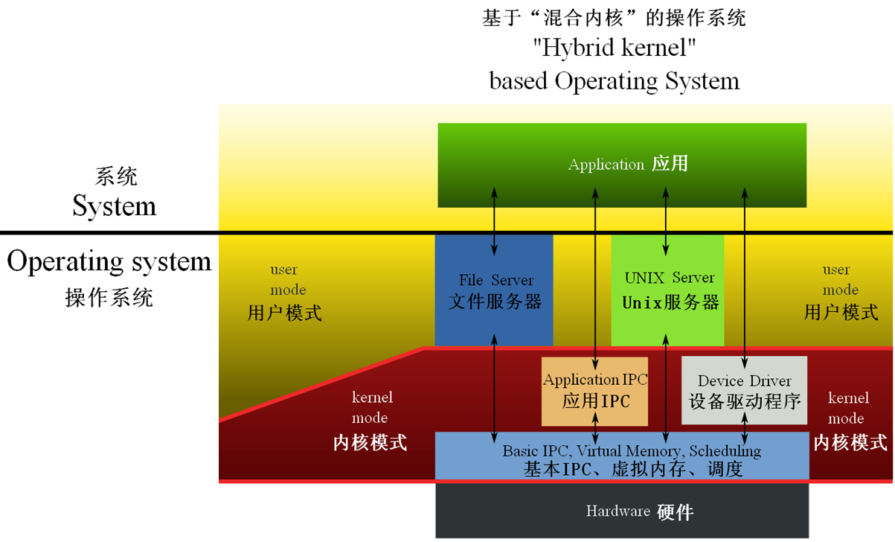
IPC = InterProcess Communication，进程间通信
VFS = Virtual File System，虚拟文件系统

Slide 47
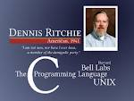
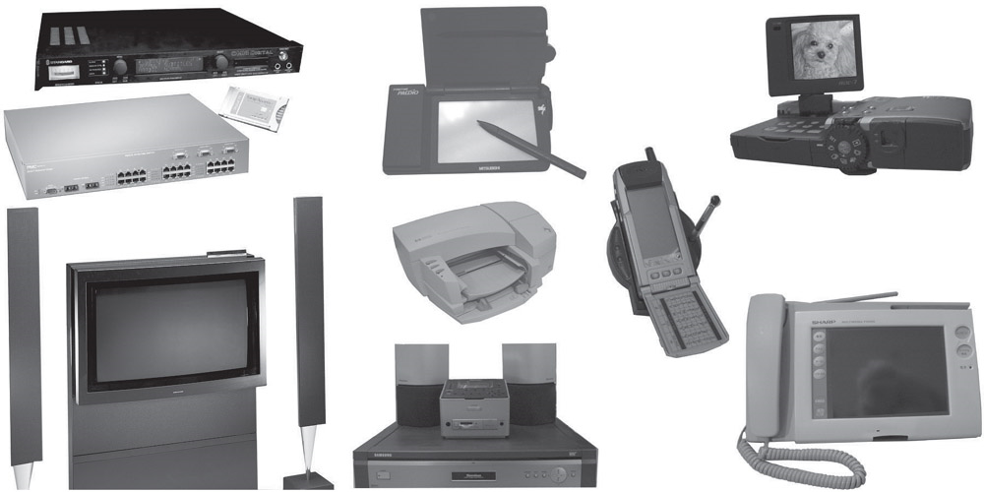
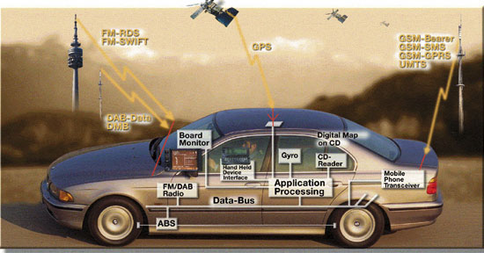
Implementing OS
Traditionally, operating systems have been written in assembly language.
Now, however, they are most commonly written in higher-level languages such as C or C++
This is why C is so important, and now is popular again because of the boom of embedding system – system programming always needs C!
Notes:
2011年暑期, 参加了东软大连暑期培训, 在那里了解到东软的发家(第一桶金)就是得益于做汽车的嵌入式系统—音响. 现在,围绕着汽车的相关研发仍然是东软的一个专门的部门!

Slide 48
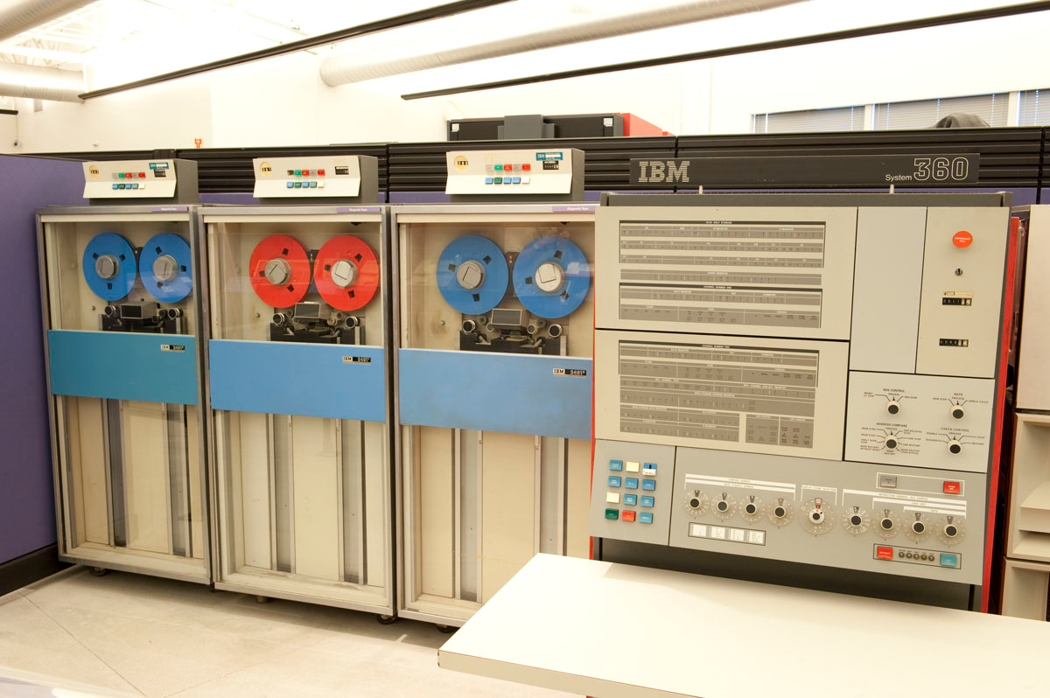
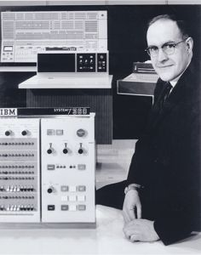

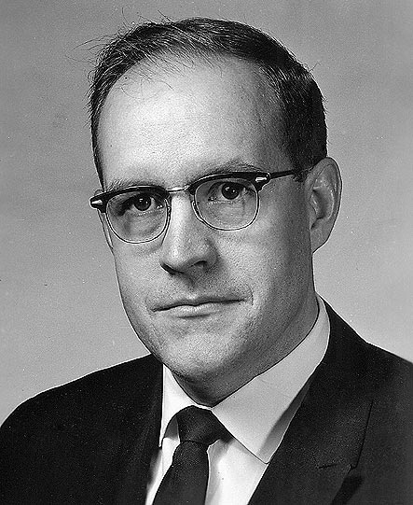
Anecdote: The complexity of implementing OS
Even triggers the consideration of Software Engineering!
IBM 360
Frederick Phillips Brooks, “The Mythical Man-Month” 《人月神话》
Notes:
IBM／360的开发总投资5．5亿美元(其中硬件2亿，软件3．5亿)，比美国研究原子弹的曼哈顿计划的投资20亿美元的四分之一还多。在研制期间，布鲁克斯率领着2000名程序员夜以继日地工作，单单360操作系统的开发就用了5000个人年。因此，当1964年4月7日，在IBM公司纪念其成立50周年的庆祝大会上宣布360系列计算机的时候，小沃森完全有理由声称“这是公司历史上宣布的最重要的产品”。
确实，IBM／360以其通用化、系列化和标准化的特点，对全世界计算机产业的发展产生了如此深远的影响，以至被认为是划时代的杰作。而IBM／360的推出，也使IBM在短短两年时间内，即到1966年，其资本积累就增加到45亿美元，职工总数净增6万，达到19万，成为名符其实的“兰色巨人”。到20世纪60年代末，360系列机的市场占有率达到15％，到20世纪70年代中期，超过了50％。各计算机生产厂商纷纷仿效360的榜样，推出各自的系列机。有的则直接采用IBM／360的操作系统，比如著名的Amdahl公司的所谓“插接兼容式”计算机(plug compatible computer)就是这样。为此，伊万斯和布鲁克斯两人常常被并称为“IBM／360之父”(father of the IBM System／360)。
《人月神话》自第一版以来，畅销20余年不衰，是软件领域绝无仅有的必读经典。作者布鲁克斯为人们管理复杂项目提供了颇具洞察力的见解，既有很多发人深省的观点，也有大量的软件工程实践。本书内容来自布鲁克斯在IBM公司 System/360 家族和OS/360中的项目管理经验。
-- http://www.techcn.com.cn/index.php?doc-view-26072.html

Slide 49
Services
Problems and ideas when implementing OS
Problems: EMM+GSD
Ideas: Multiplex resource + Synchronize programs
Construct OS
Evolution of OSs’s structures
How do users use the functions defined in OS?
System Call/API ← Just as Function call you’ve learned
How to load and run OS?
POST → BIOS/CMOS → (Boot) loader
Firmware (ROM)

Slide 50
Application
Programmer
Software API
Command
Line
Interpreter
Loader
Window
System
Libraries
Libraries
System Software
Libraries
Compiler
OS
Database
Management
System
Hardware
PPTs.2012\Part 03 OS structures-FL.pptx
Notes:
[2016年3月8日15:26:54] Providing services for other programs (local or remote) – System Call
[2015年3月19日20:41:27 逸夫西楼811] 之前已经学习过：OS有两个角色 – Resource Manager. In fact, OS exists for the users as a server to provide necessary services. Intuitively we all know that it’s not safe to let common users to directly control the devices.

Slide 51
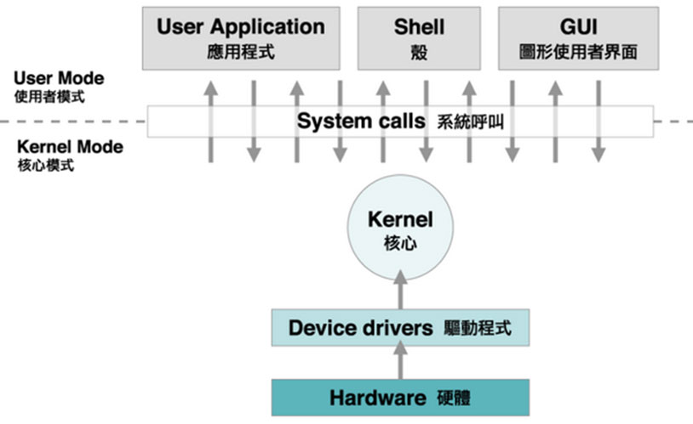
That’s the reason why you should INCLUDE IO, FILE headers in C
http://mlinking.blog.163.com/blog/static/18580192220131101314948/

Slide 52
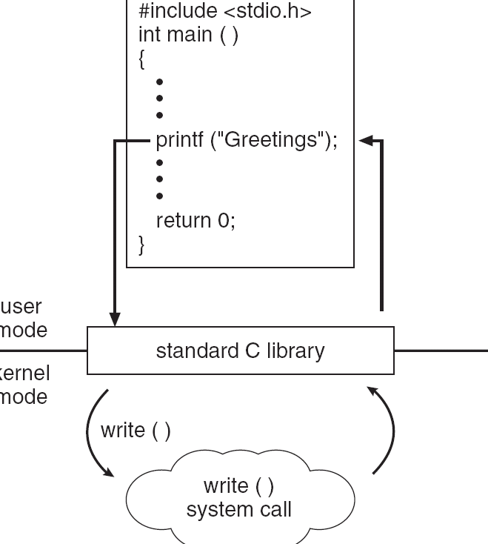
System Call/API: interface between user programs and OS services
Application Program Interface 应用程序接口
C program invoking printf() library call, which calls write() system call
Advice to learn a HPL:
Besides the learning of the basic programming skills (syntax, function declaration, supported data types & operations, etc.), you should learn how to use the ready-to-use functions provided in predefined libraries.
Learn the methods used for the problems in ACM, mathematics
Notes:
[2016年3月8日15:27:47] With the help of Compiler/Interpreter, some stubs to call system functions have been marked. When executing, OS will trap those functions into so-called kernel space, finish the needed computations, and return the result (pass-by-value or shared memory)

Slide 53
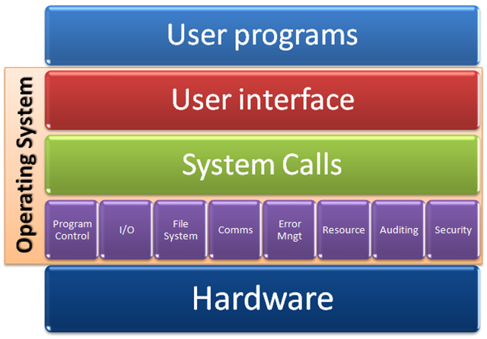
Notes:
http://blogs.msdn.com/b/willy-peter_schaub/archive/2010/01/07/unisa-chatter-operating-system-concepts-part-2-system-structures.aspx

Slide 54
Services
Problems and ideas when implementing OS
Problems: EMM+GSD
Ideas: Multiplex resource + Synchronize programs
Construct OS
Evolution of OSs’s structures
How to use the functions defined in OS?
System Call/API
How to load and run OS?
POST → BIOS/CMOS → (Boot) loader
Firmware (ROM)

Slide 55
Before you use your OS
When you turn on the power of your computer, the first program that runs is usually a set of instructions kept in the computer's read-only memory (ROM).
This code examines the system hardware to make sure everything is functioning properly.
3 subprograms: POST, BIOS, Boot loader
Sometimes, loader is believed as part of BIOS in some textbooks
This power-on self test (POST) checks the CPU, memory, and basic input-output systems (BIOS) for errors and stores the result in a special memory location (CMOS).
Once the POST has successfully completed, the software loaded in ROM (sometimes called the BIOS or firmware [固件]) will begin to activate the computer's disk drives.
Notes:
DEL, F2 …

Slide 56
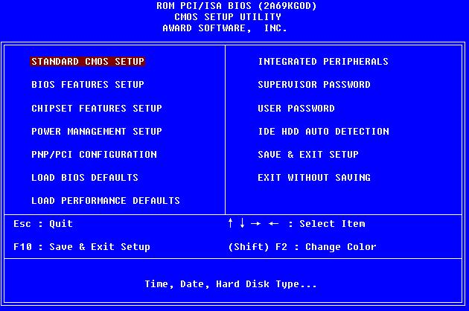

Slide 57
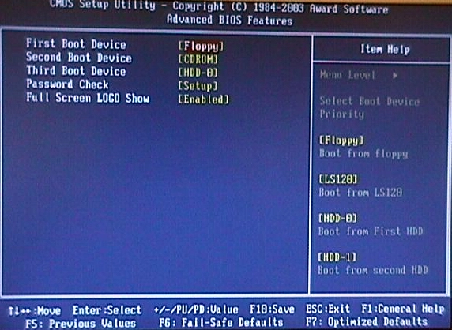

Slide 58
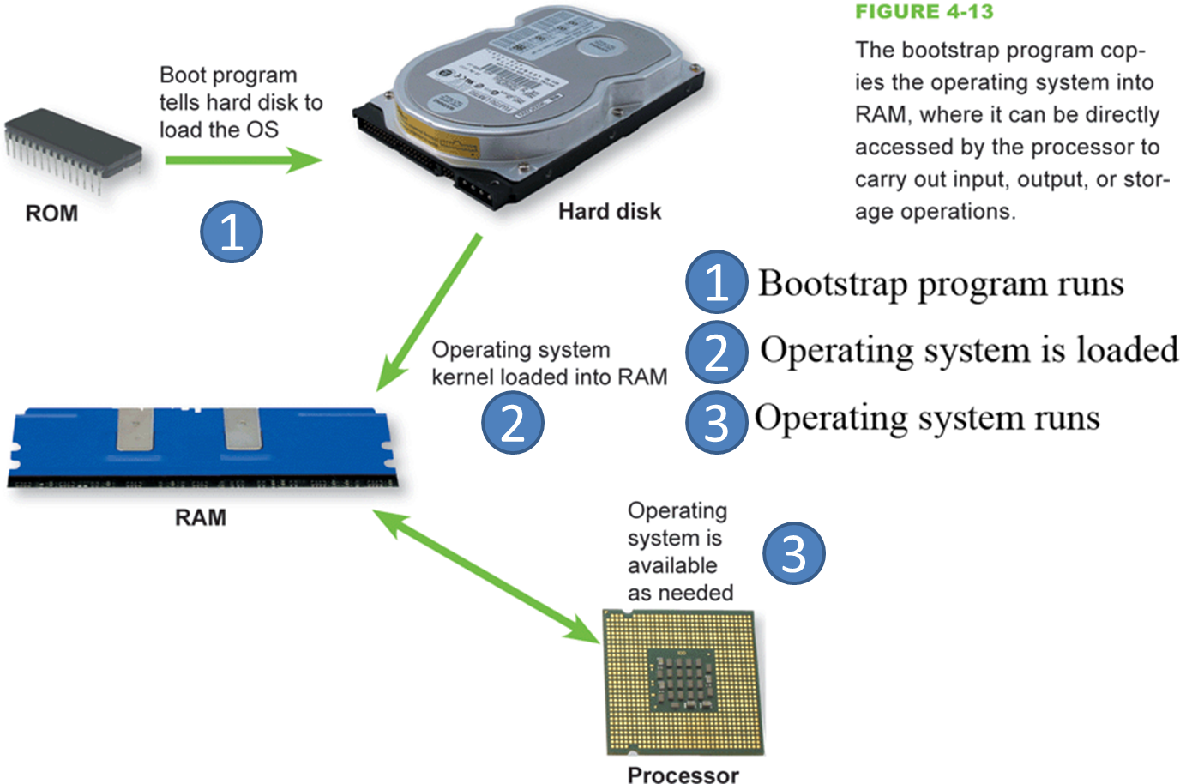
Before you use your OS
The bootstrap loader is a small program that has a single function：It loads the operating system into memory and allows it to begin operation.
Generally its implementation consists of 2 parts stored separately in CMOS and the first piece of system HD

Slide 59

Then it’s OS!

Slide 60


Security risk is everywhere
http://answers.microsoft.com/en-us/windows/forum/windows_7-security/uefi-secure-boot-in-windows-81/65d74e19-9572-4a91-85aa-57fa783f0759

Slide 61

Your try
The UEFI Boot Manager controls the program flow across the 6 phases

